Slide 1
6 October until 2 December 2015
Visitation to Brazil

Slide 2
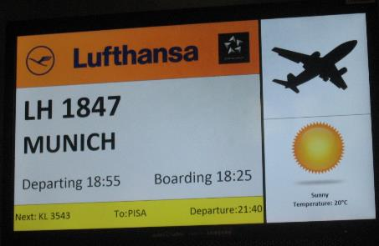
From Rome to Munich
and
from Munich to Sao Paulo

Slide 3
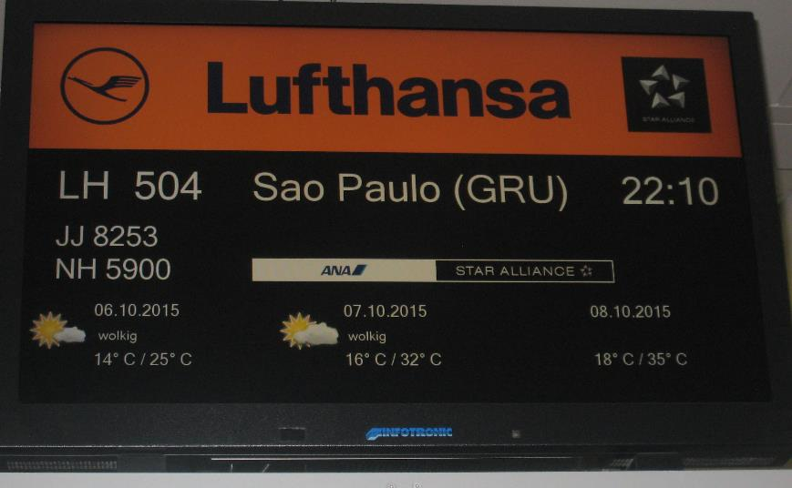
It promised to be a hot time, especially for Sr. Elly!!

Slide 4
Arrival in Sao Paulo - Vila Formosa
Mother House and Formation House.

Slide 5
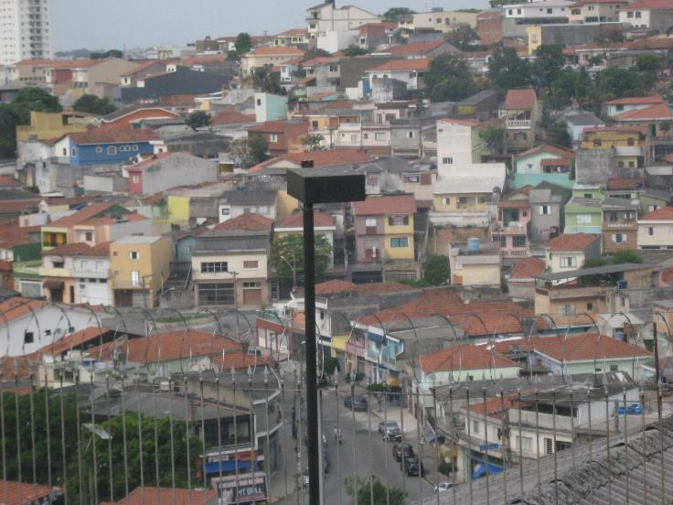
In a poor area of Sao Paulo

Slide 6
All the Sisters were
waiting for us!!
A very warm welcome!!!

Slide 7
Provincialate: discussing the program for the coming weeks.

Slide 8
Social work Sao Jose

Slide 9
College of Our Lady of the Sacred Heart

Slide 10
The Novitiate

Slide 11
Campinas

Slide 13
Chapel with the choir of sisters
and Associates

Slide 14
Crèche Mother Marie Louise Hartzer

Slide 15
Social work Mother Marie Louise Hartzer

Slide 16
Vida Nova

Slide 17
ITAJUBA

Slide 18
College of the Sacred Heart of Jesus
in Alfenas

Slide 19
Social work s. José

Slide 20
Santa Casa
Alfenas

Slide 21
College Divinopolis

Slide 22
Vila Vicentina Divinopolis

Slide 23
Mirinzal

Slide 24
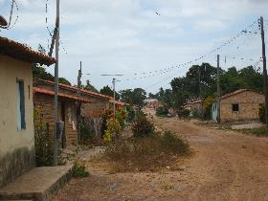
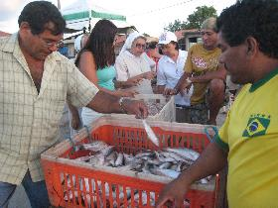
Apicu Açu

Slide 26
Brasilia
College of Our Lady of Perpetual Help

Slide 27
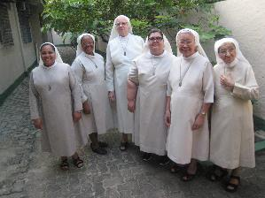
Rio de Janeiro

Slide 28
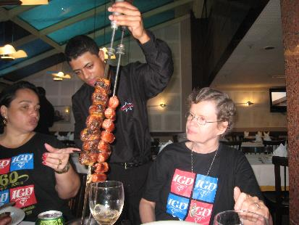
Time for relaxation

Slide 29
Curitiba

Slide 31
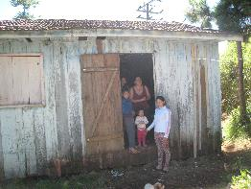
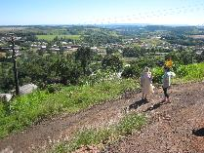
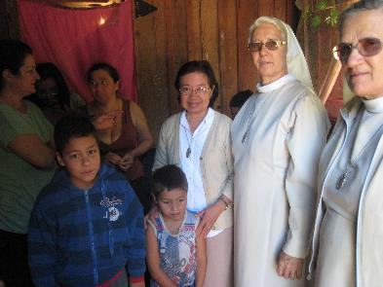
Baracaõ

Slide 33
Capanema

Slide 35
Iguazu falls
Itaipu Dam

