Slide 1
15 February – early morning Mass at the Comboni Chapel and meeting the “blind” after the Mass
Fr Pelerino, mccj
The “blind” with their children, welcoming us after the Mass

Slide 2
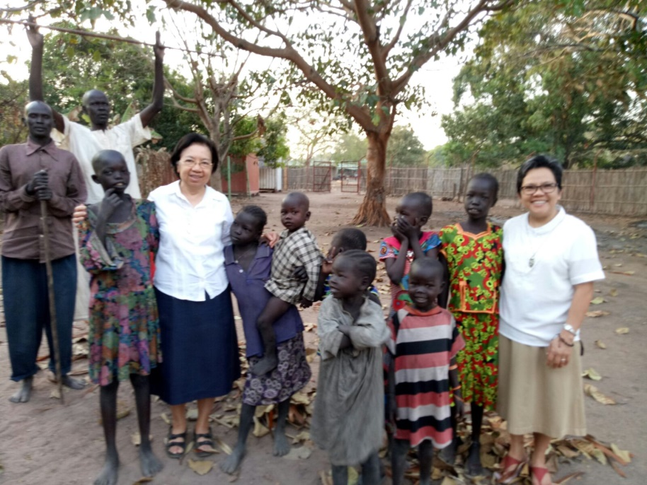
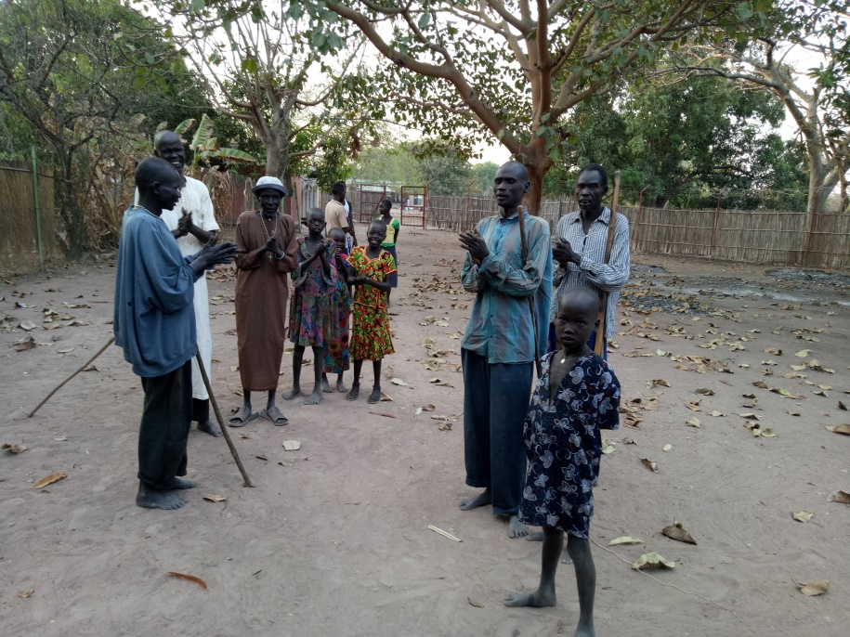
The people who come to Mass everyday.

Slide 3
Meeting the Secondary School Staff and Students

Slide 4
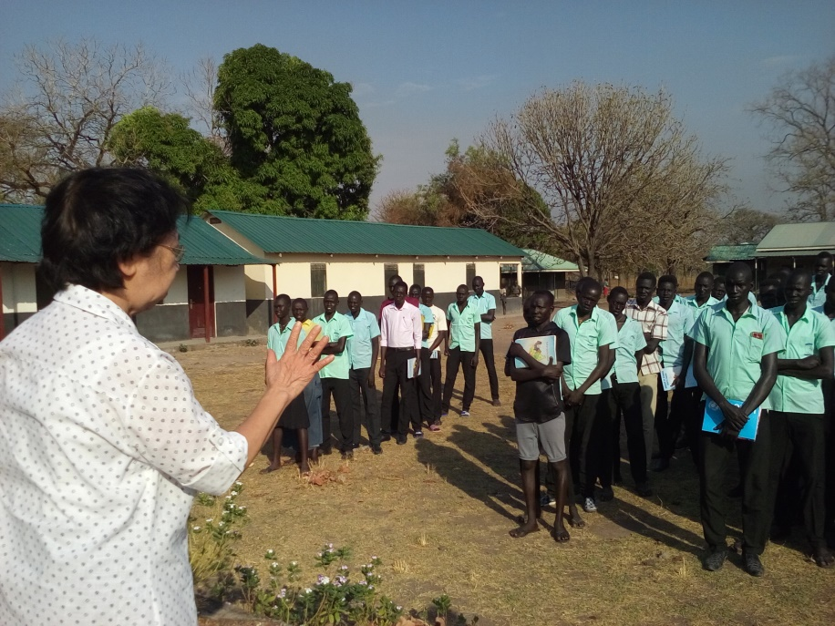
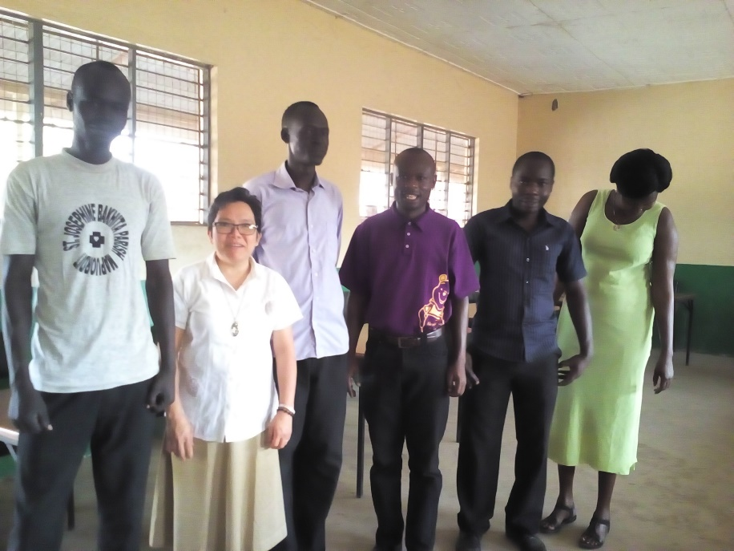

Slide 5
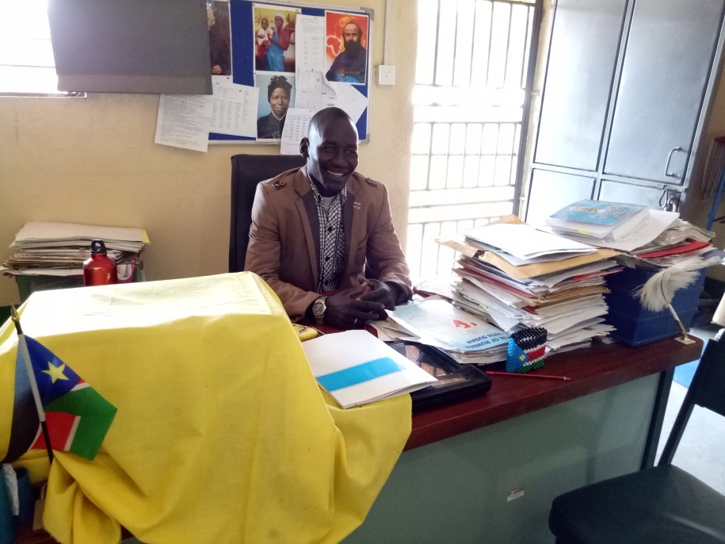
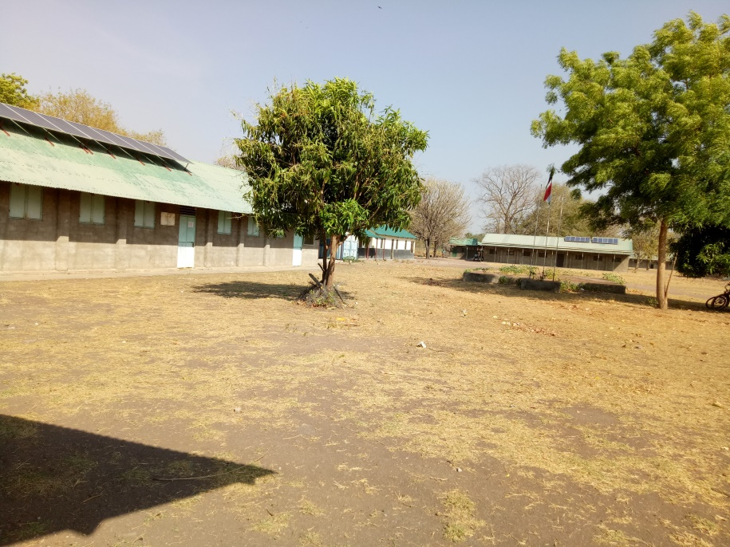
School Principal

Slide 6
The Village Payyam (i.e. local government office)
Going around Mapuordit and meeting people
Inside the Payyam with the men working in the office

Slide 7
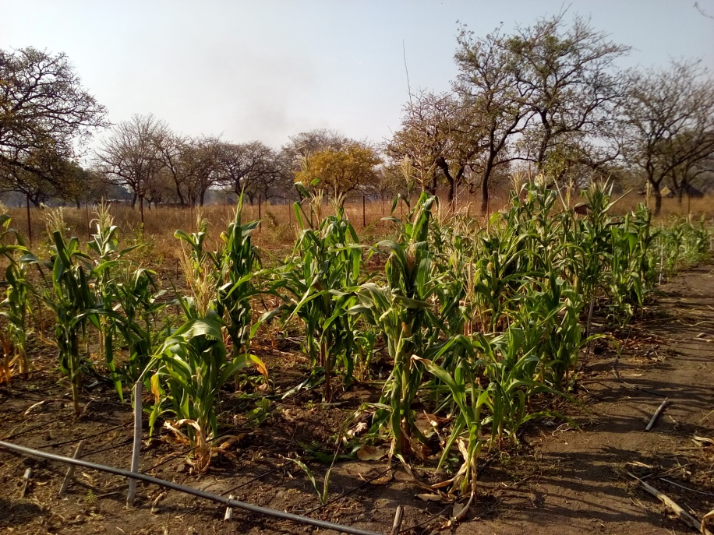
Going around Mapuordit and meeting people
One of Sr Rita’s projects, a community garden

Slide 8
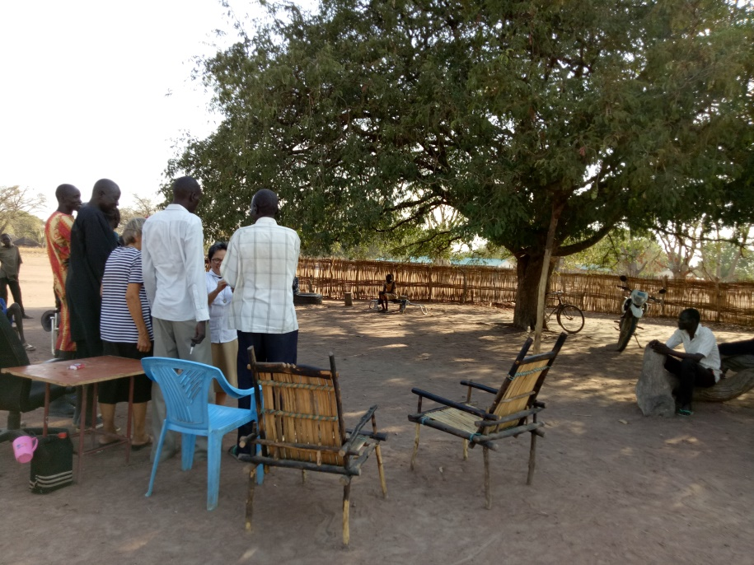
Going around Mapuordit and meeting people
Encountering the chief and his council of elders in their “courthouse” under a tree.

