Slide 1
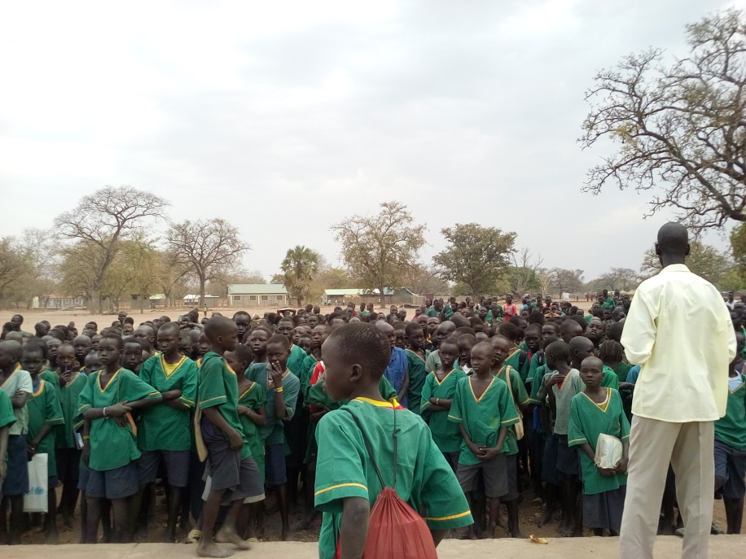
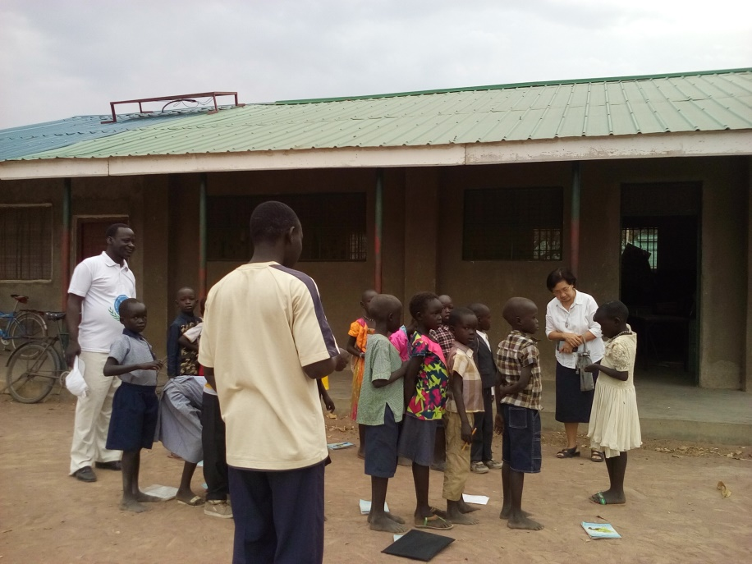
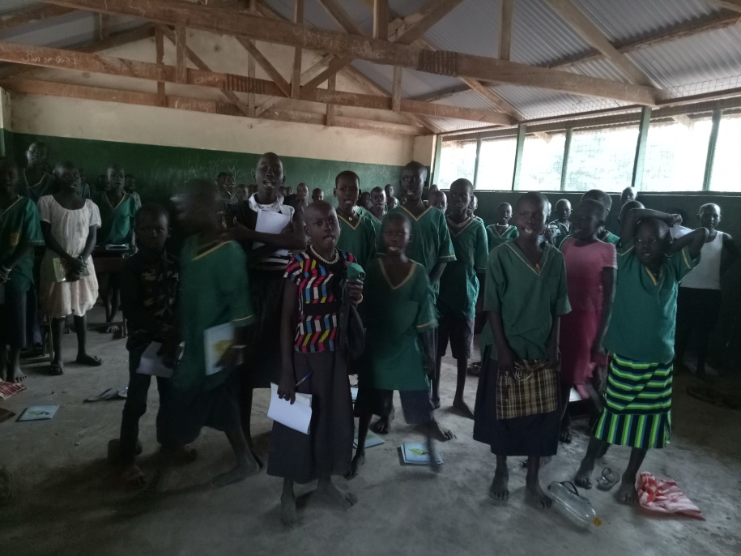
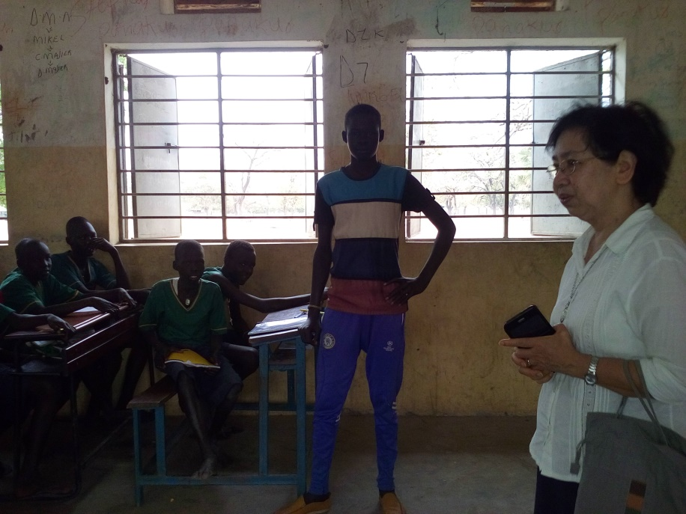

Slide 2
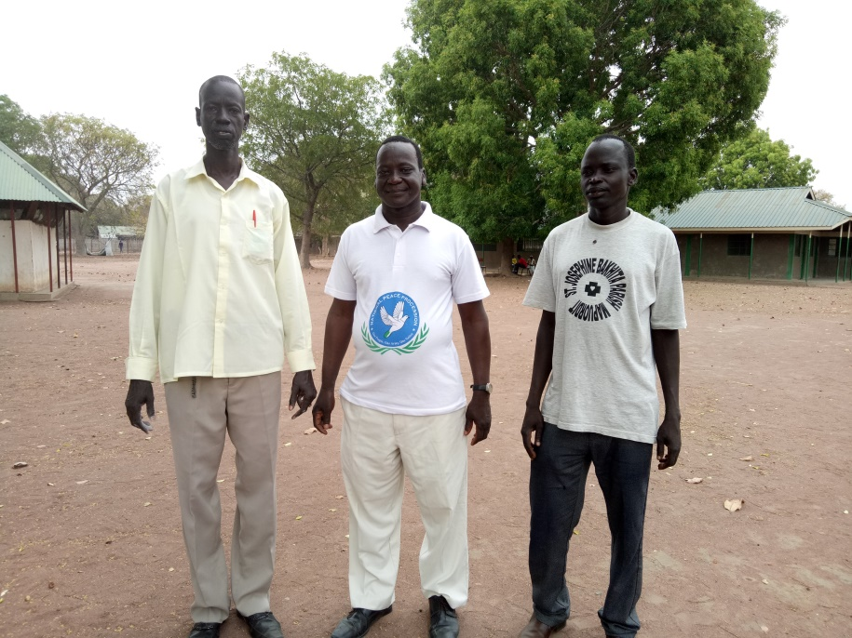
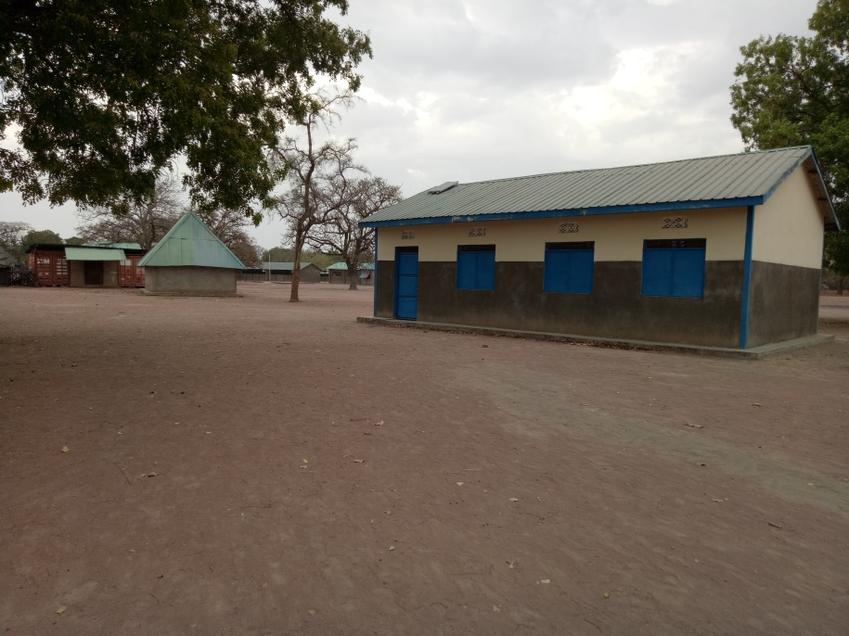
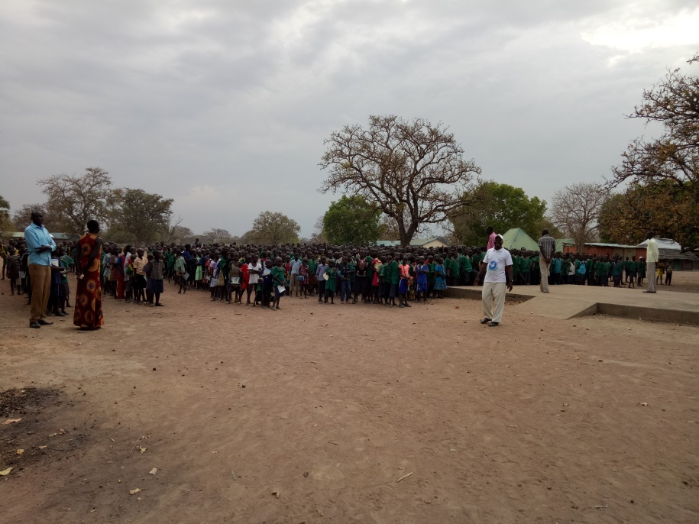
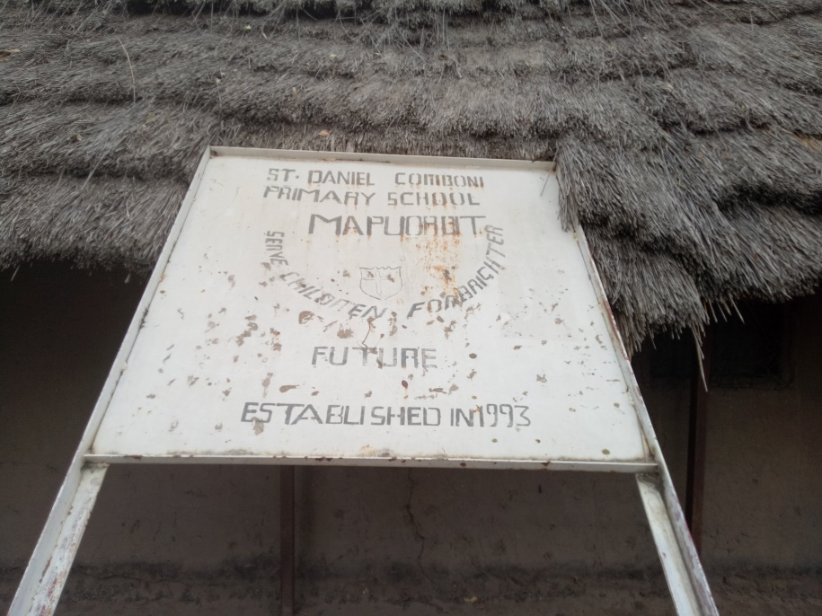
The Principal (middle) and his two Assistants

Slide 3
Welcoming the poor and hungry that come to our gate
Sr Wendy with her Tuesday group
Sr Rita talking to a poor woman outside our gate

Slide 4
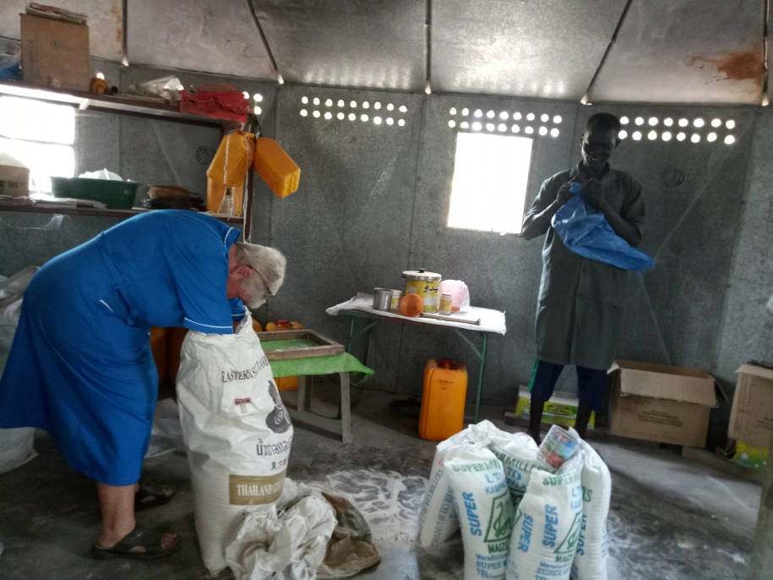
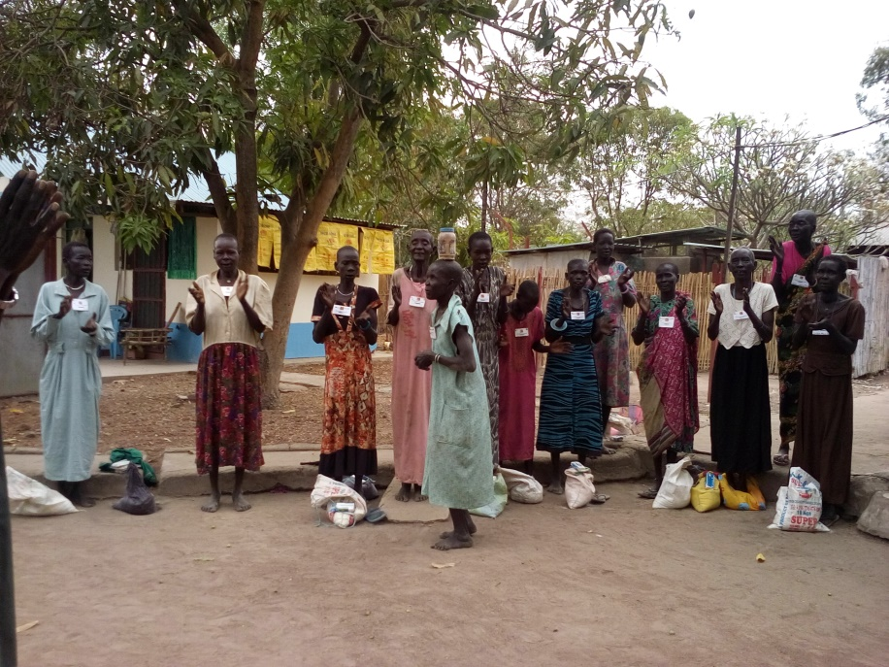
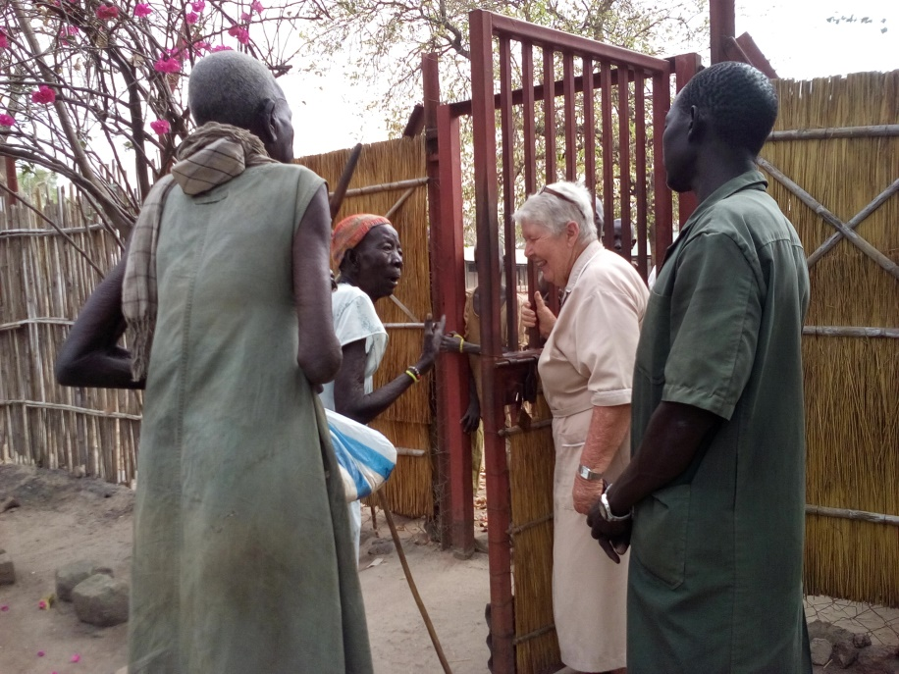
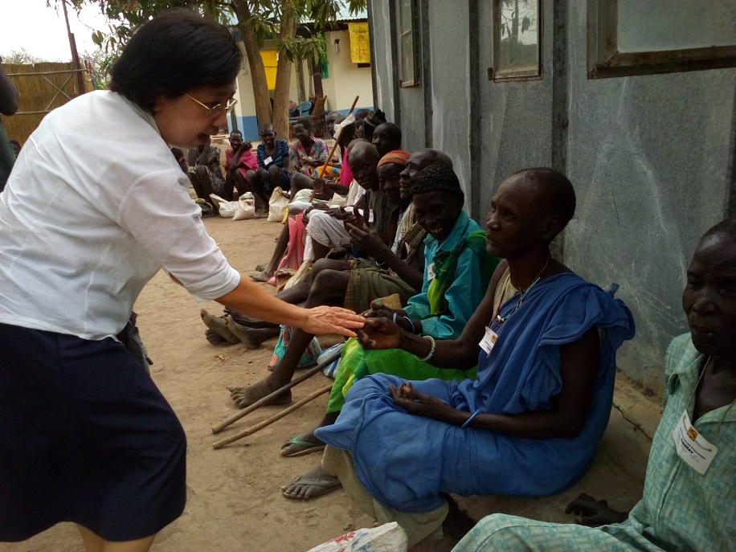
Inside, Sr Wendy and Kulang prepare the food for distribution
Outside, a group of hungry, thirsty people are waiting to be let in

Slide 5
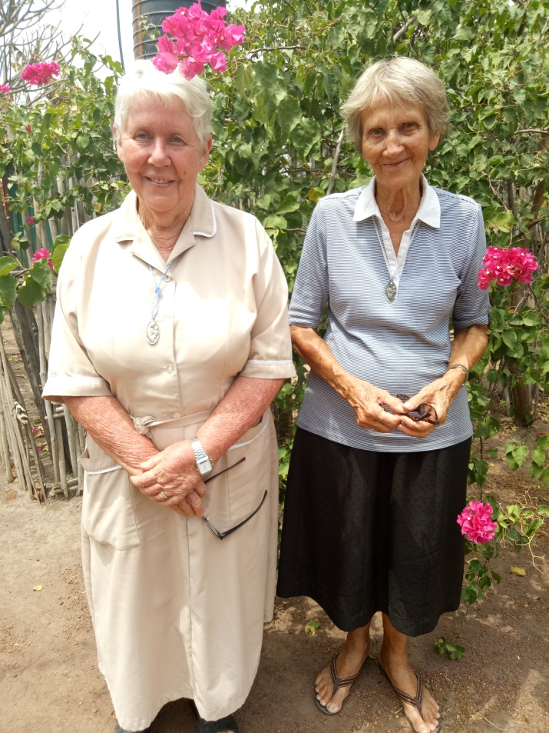
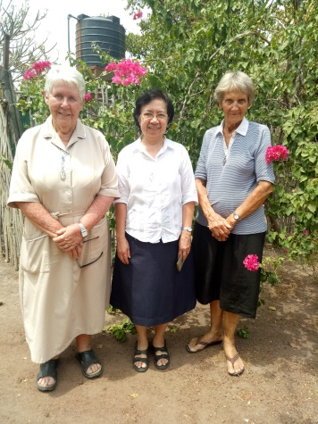
Last day in Mapuordit, 21 February Final community meeting and official picture taking

Slide 6
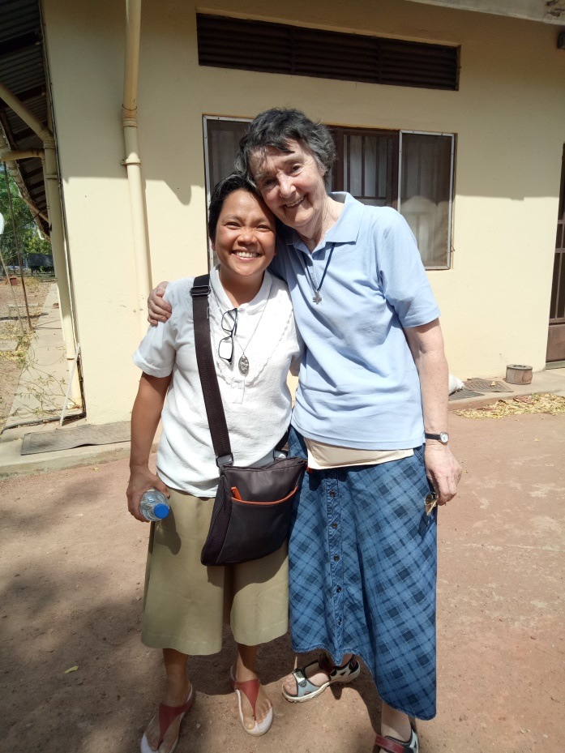
On 22 February, Feast of Mother Marie Louise, we travelled to Rumbek accompanied by Sr Rita.
In Rumbek, we visited other religious congregations in the diocese
The Community of the Loreto Sisters with their lay worker and a De La Salle brother from Congo who will begin a secondary school for boys in the area.
Classmates in Jerusalem inn 2007, meeting in Rumbek after 10 years!

Slide 7
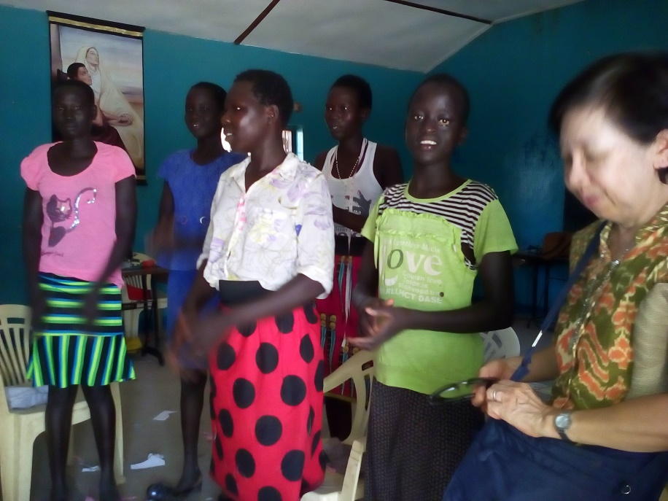
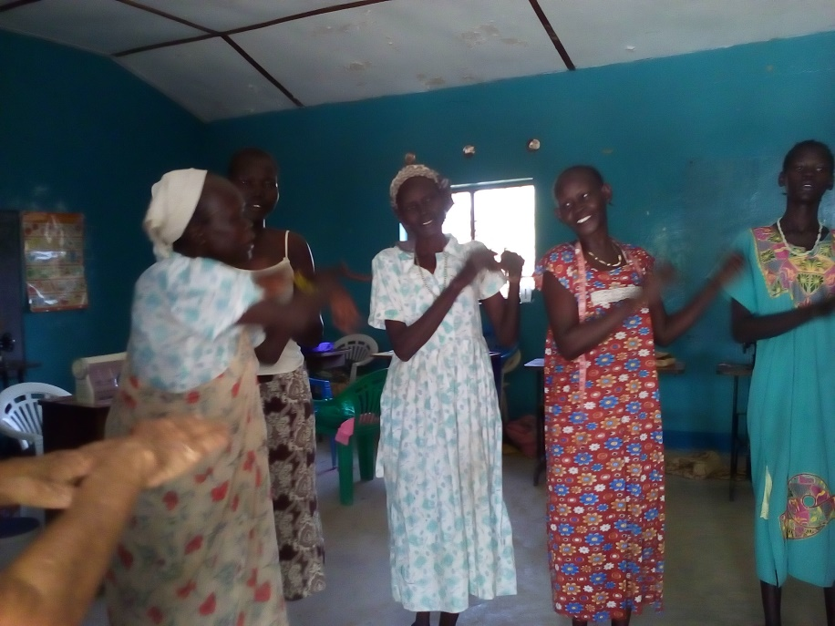
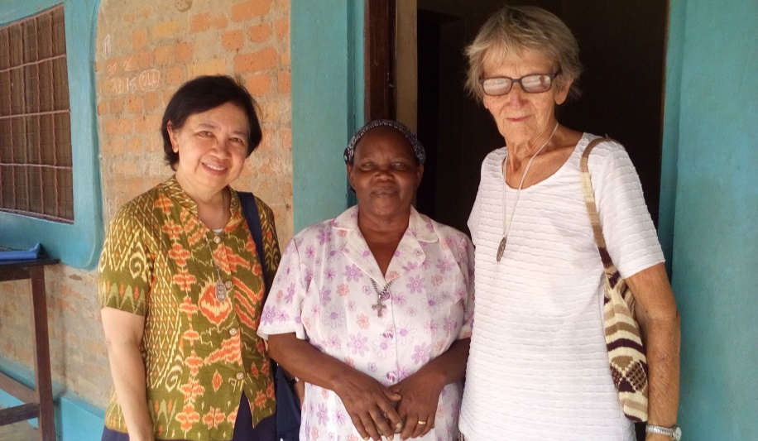
Visiting a Kenyan Good Shepherd Sister and the women she empowers and trains

Slide 8
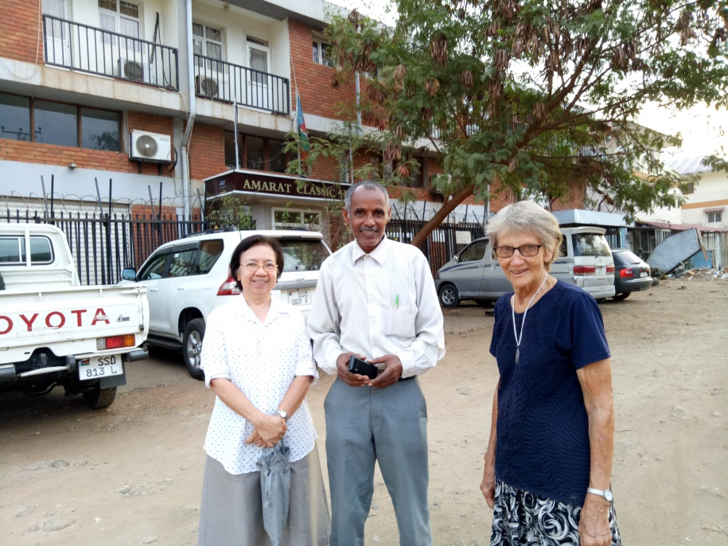
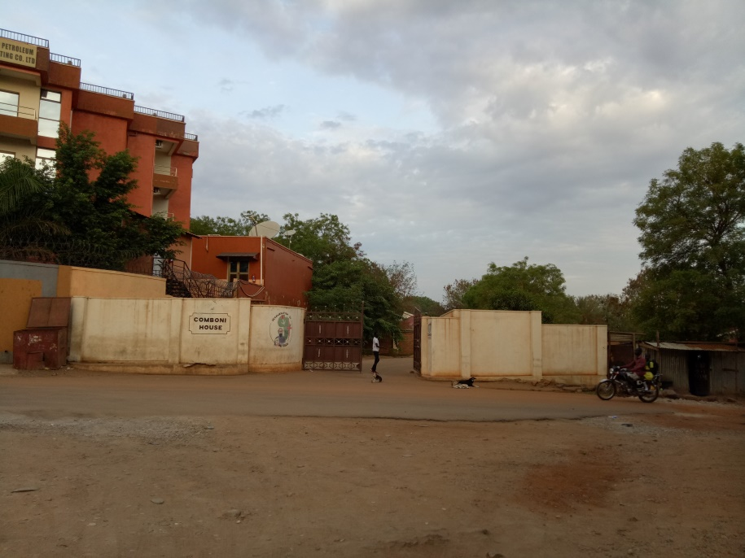
Afternoon of 22 Feb, we flew to Juba on a World Food Program (WFP) plane. In Juba, we met with Fr Placide, the Comboni superior in Mapuordit and visited the Good Shepherd Peace Center staffed by Solidarity for South Sudan
With Mesfin, the hotel driver and our angel in Juba .
The Hotel in Juba where we stayed
The Comboni Compound in Juba

Slide 9
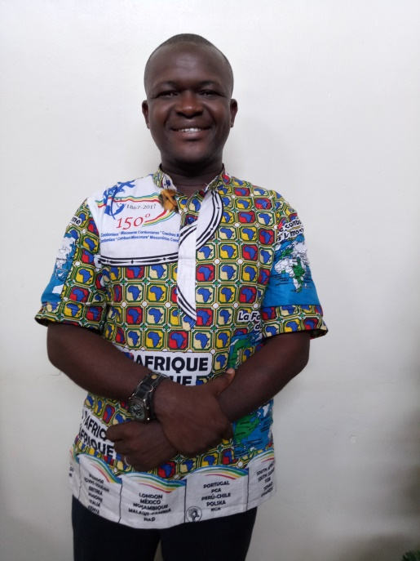
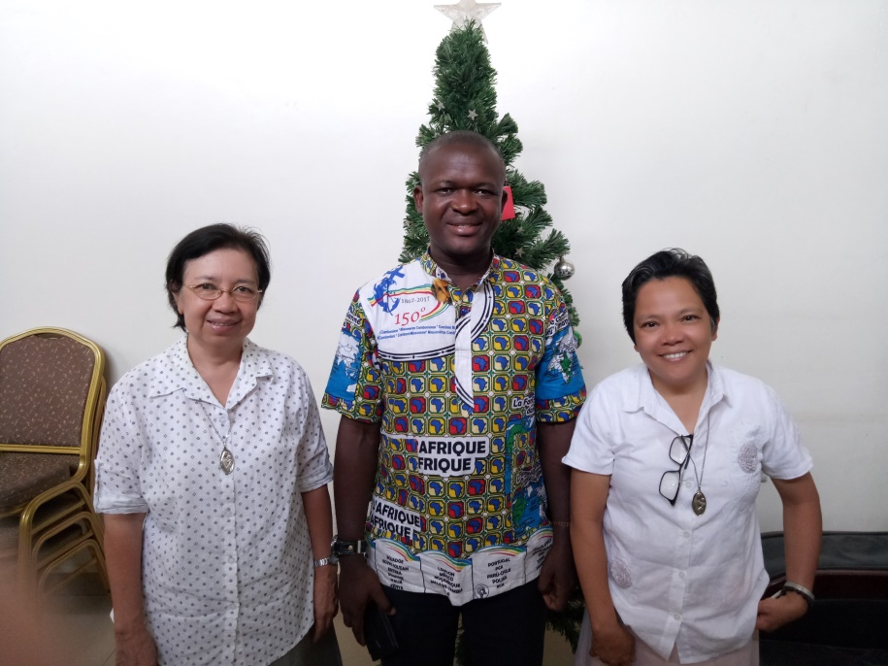
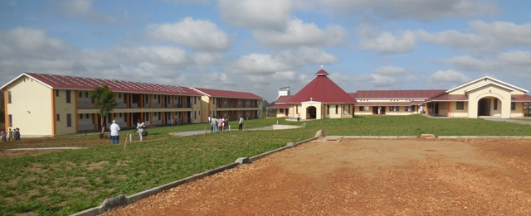
Fr Placide, Comboni Missionary
Good Shepherd Peace Center in Juba

Slide 10
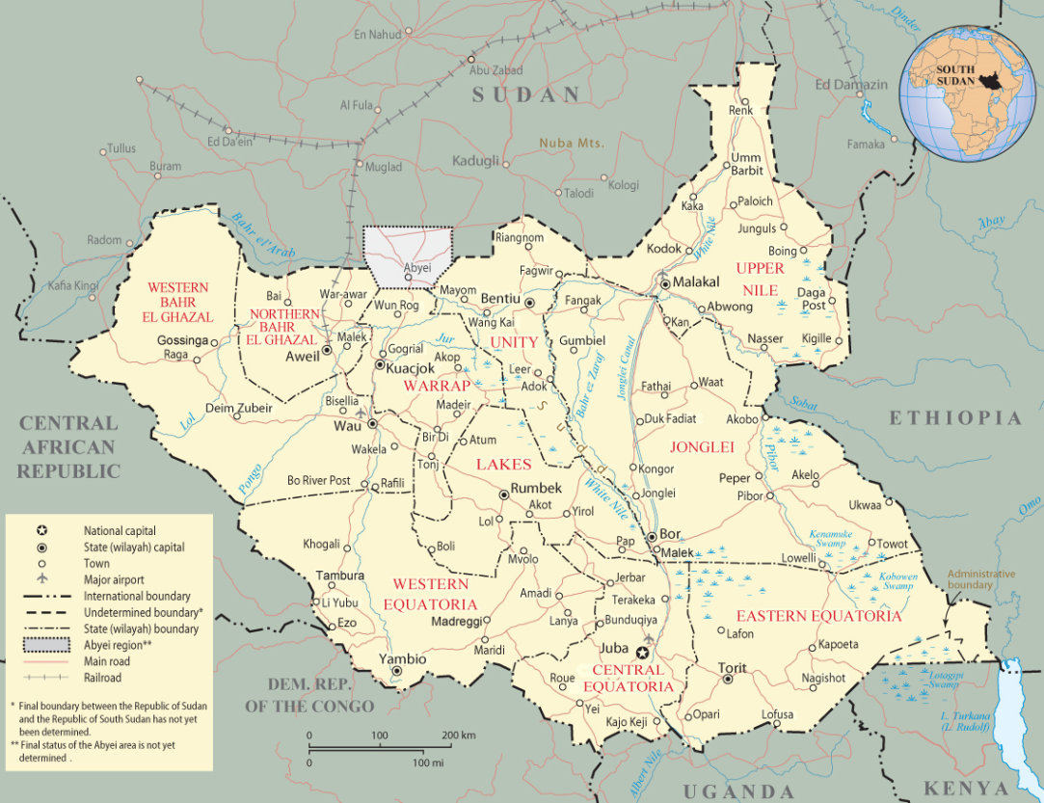
GOODBYE SOUTH SUDAN
On 23 February 2018, the International Day of Prayer for Peace in the DR of Congo and South Sudan, we left Juba with our hearts full of gratitude.
We left truly praying for the peace of South Sudan.
We arrived back in Rome on 24 February

